Slide 1

Hotel Reservation Analysis
Presented By – Shrimani Tundurwar
Data Analyst Intern
Batch - MIP-DA-10

Slide 2

Table Of Contents
INTRODUCTION
PROBLEM STATEMENT
DATASET DESCRIPTION
DATA EXPLORATION AND ANALYSIS
INSIGHTS

Slide 3
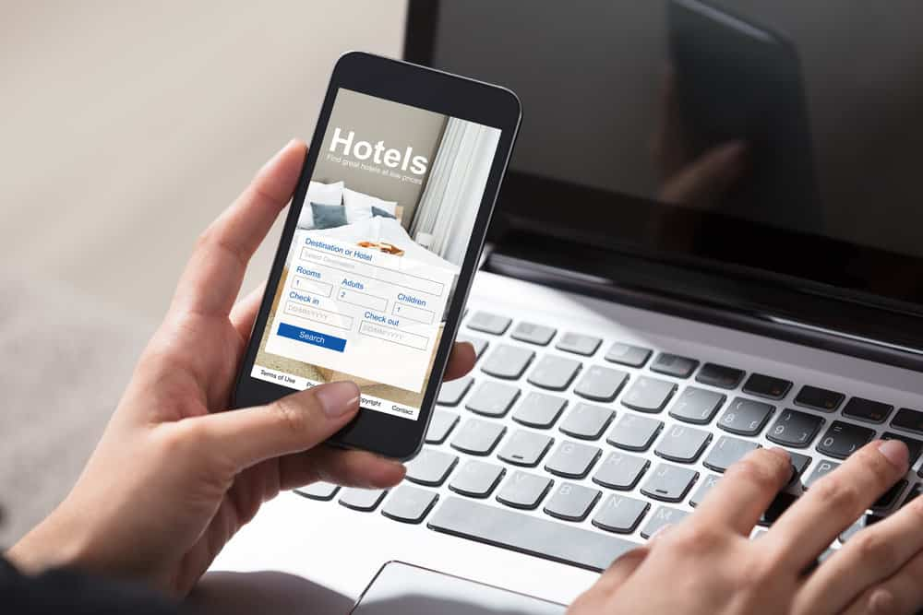
INTRODUCTION
The hotel industry relies on data to make informed decisions and provide a better guest experience.
In this project , I worked with a comprehensive hotel reservation dataset to uncover valuable insights into guest preferences, booking trends, and other key factors that influence hotel operations.

Slide 4

PROBLEM STATEMENT
I am tasked with analyzing a hotel reservation dataset to uncover critical insights that can enhance the decision-making process and improve the guest experience.
By using SQL to query the dataset, I will address key questions such as the total number of reservations, the most popular meal plans, and booking trends over specific years and months. Additionally, I will identify the most commonly booked room types, weekend reservation patterns, and lead times for bookings. The analysis will explore the distribution of market segments, the total number of adults and children across all reservations, and the average duration of stays. These insights will be instrumental in developing data-driven strategies to optimize hotel operations and enhance guest satisfaction.

Slide 5
DATASET DESCRIPTION
The dataset used for this analysis provides comprehensive information about the hotel reservations. It includes the following columns:
Booking_ID: A unique identifier for each hotel reservation.
no_of_adults: The number of adults in the reservation.
no_of_children: The number of children in the reservation.
no_of_weekend_nights: The number of nights in the reservation that fall on weekends.
no_of_week_nights: The number of nights in the reservation that fall on weekdays.
type_of_meal_plan: The meal plan chosen by the guests.
room_type_reserved: The type of room reserved by the guests.
lead_time: The number of days between booking and arrival.
arrival_date: The date of arrival.
market_segment_type: The market segment to which the reservation belongs.
avg_price_per_room: The average price per room in the reservation.
booking_status: The status of the booking.
Total 700 reservation were made according to the data.

Slide 6
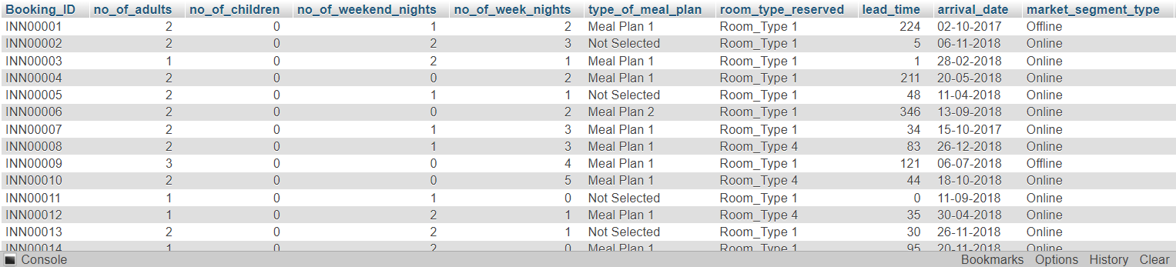
Overview of the dataset:

Slide 7
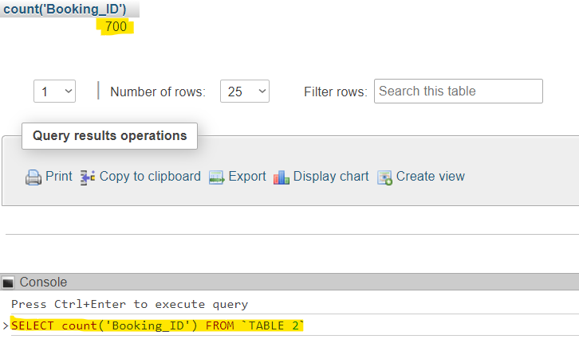
DATA EXPLORATION AND ANALYSIS
Query 1
1. What is the total number of reservations in the dataset?
Query Result
SQL Query
Total 700 reservations were made as per the dataset.

Slide 8
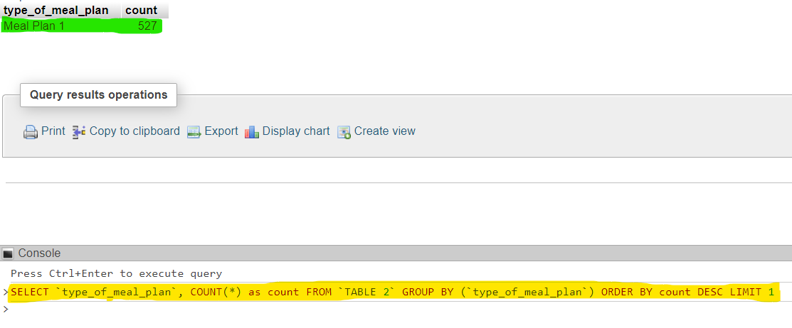
DATA EXPLORATION AND ANALYSIS
Query 2
2. Which meal plan is the most popular among guests?
Query Result
SQL Query
‘Meal plan 1’ seems to be the most popular among guests. 527 guests selected this type of meal plan.

Slide 9
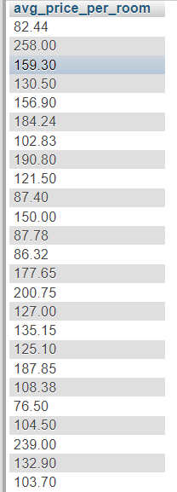
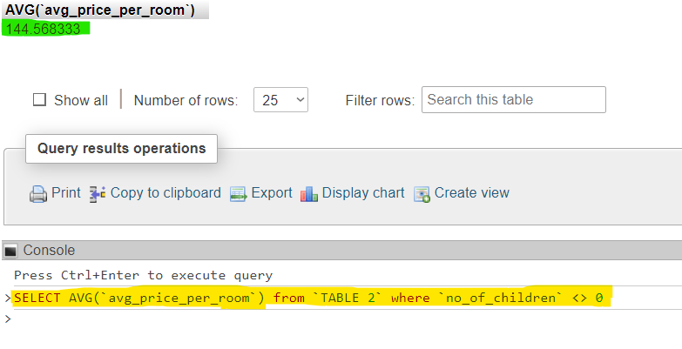
DATA EXPLORATION AND ANALYSIS
Query 3
3. What is the average price per room for reservations involving children?
Query Result
SQL Query
Average price per room for reservations involving children is 144.57 units.

Slide 10
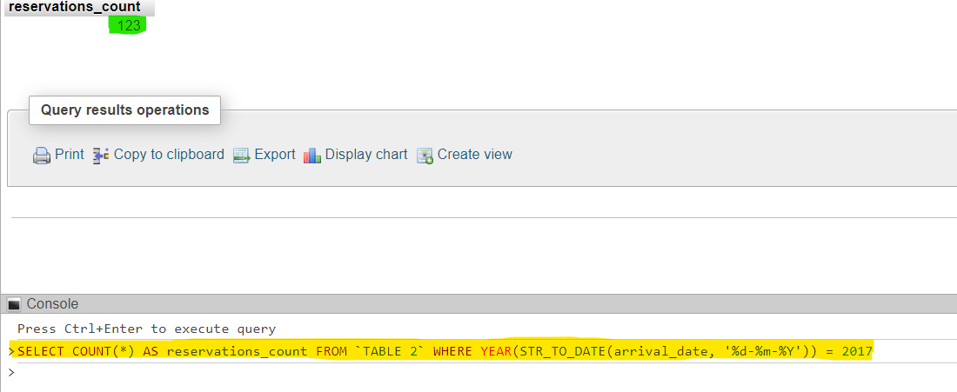
DATA EXPLORATION AND ANALYSIS
Query 4
4. How many reservations were made for the year 2017?
Query Result
SQL Query
Total 123 reservations were made in the year 2017.

Slide 11
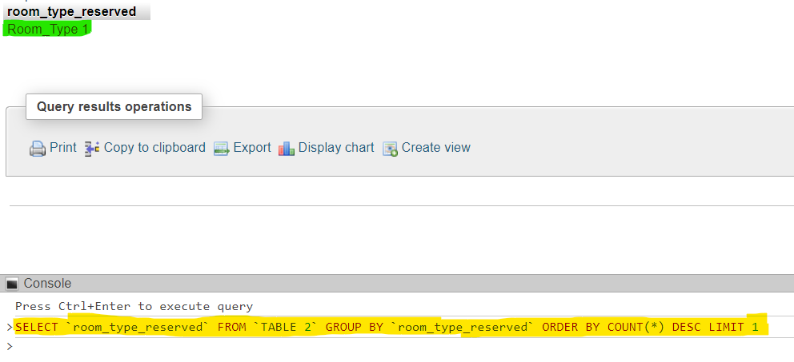
DATA EXPLORATION AND ANALYSIS
Query 5
5. What is the most commonly booked room type?
Query Result
SQL Query
Most commonly room type booked by the guests was seen to be “Room Type 1”.

Slide 12
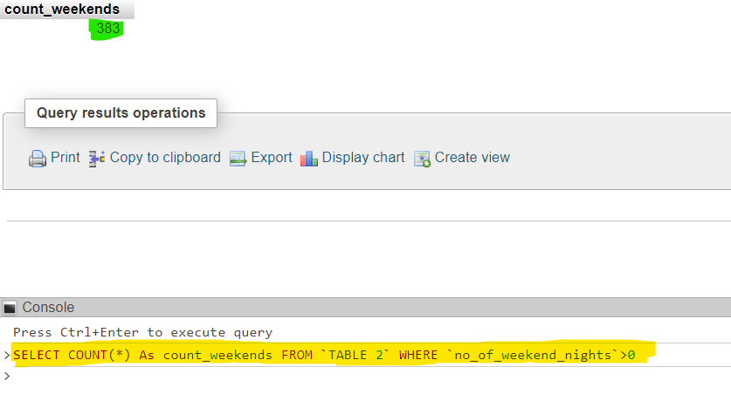
DATA EXPLORATION AND ANALYSIS
Query 6
6. How many reservations fall on a weekend (no_of_weekend_nights > 0)?
Query Result
SQL Query
Number of reservations which included weekend nights were 383.

Slide 13
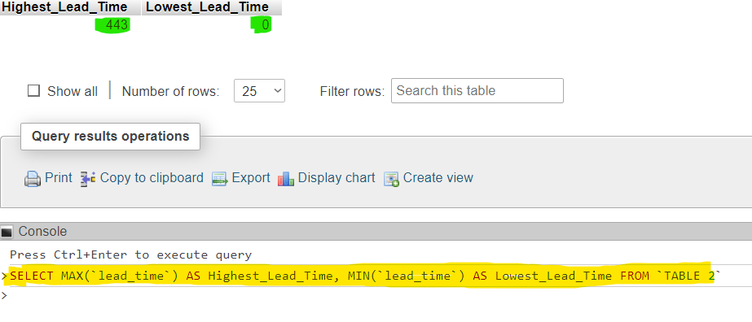
DATA EXPLORATION AND ANALYSIS
Query 7
7. What is the highest and lowest lead time for reservations?
Query Result
SQL Query
Highest and Lowest Lead Time were 443 and 0 units recorded as per the data.

Slide 14
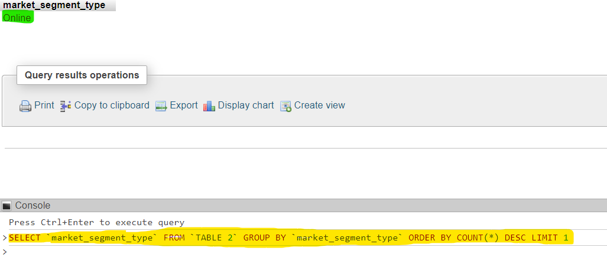
DATA EXPLORATION AND ANALYSIS
Query 8
8. What is the most common market segment type for reservations?
Query Result
SQL Query
Online medium is the most common method for reservations.

Slide 15
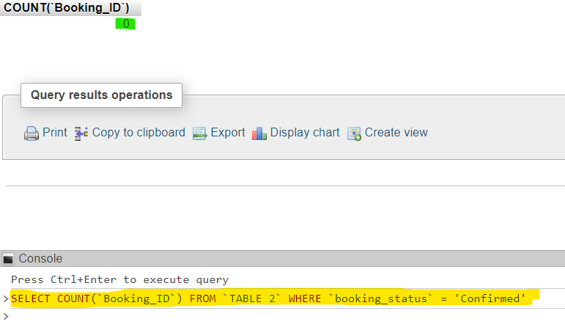
DATA EXPLORATION AND ANALYSIS
Query 9
9. How many reservations have a booking status of "Confirmed"?
Query Result
SQL Query
There were no reservations stating that the booking_status as “Confirmed”.
It was either “Cancelled” or “Not Cancelled”.

Slide 16
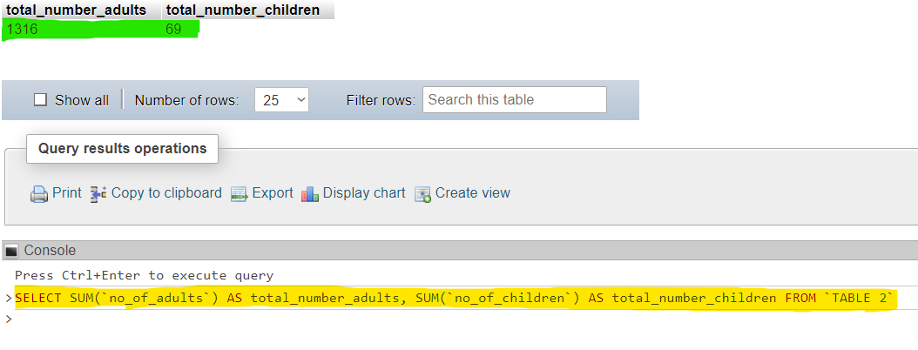
DATA EXPLORATION AND ANALYSIS
Query 10
10. What is the total number of adults and children across all reservations?
Query Result
SQL Query
The total no. of children and adults across all reservations were “69” and “1316” respectively as per the records.

Slide 17
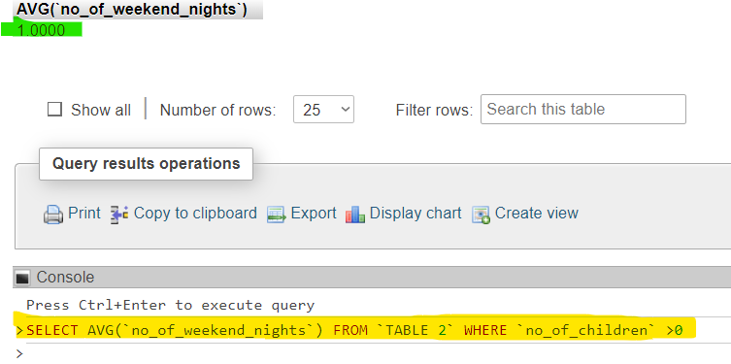
DATA EXPLORATION AND ANALYSIS
Query 11
11. What is the average number of weekend nights for reservations involving children?
Query Result
SQL Query
Average number of weekend nights for reservations involving children is “1”.

Slide 18
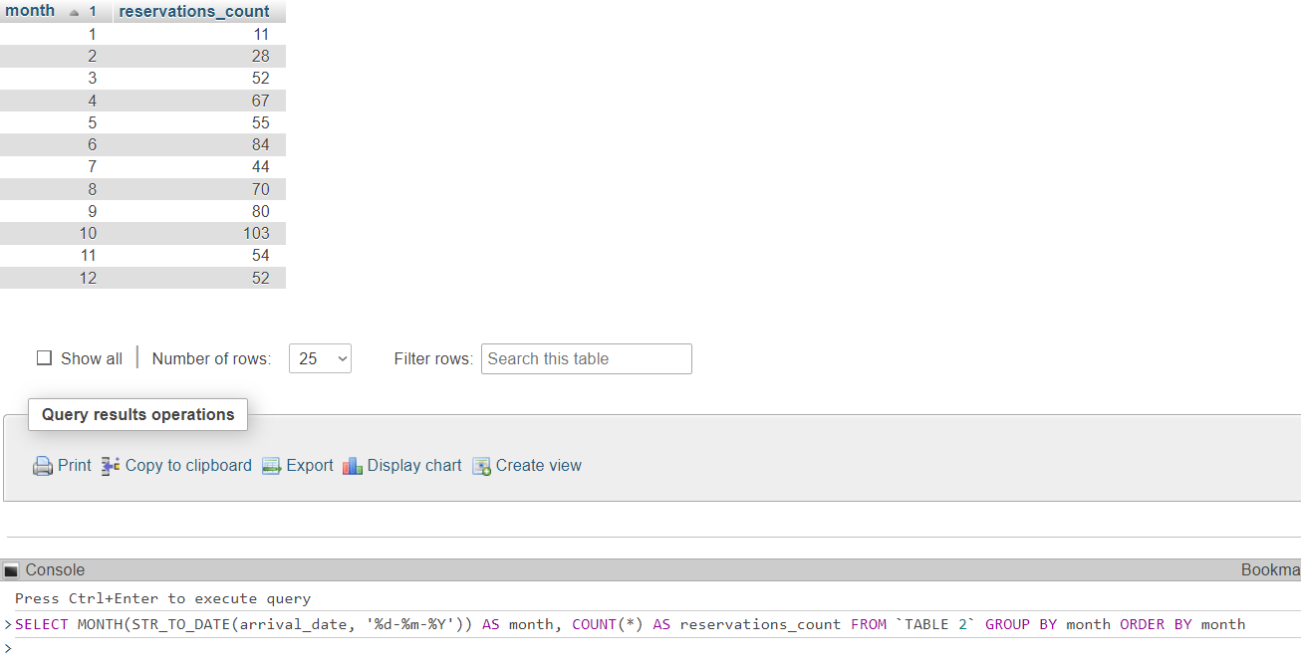
DATA EXPLORATION AND ANALYSIS
Query 12
12. How many reservations were made in each month of the year?
Query Result
SQL Query

Slide 19
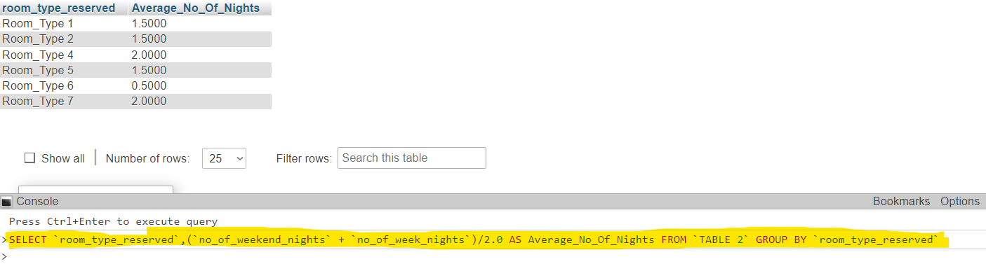
DATA EXPLORATION AND ANALYSIS
Query 13
What is the average number of nights (both weekend and weekday) spent by guests for each room type?
Query Result
SQL Query

Slide 20
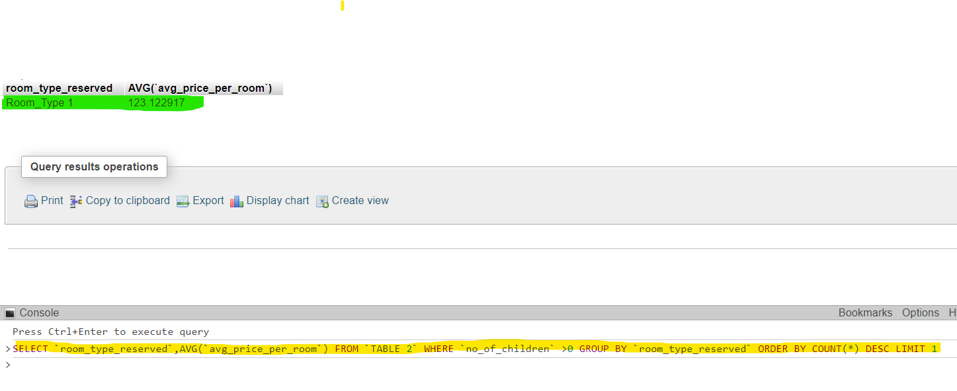
DATA EXPLORATION AND ANALYSIS
Query 14
14. For reservations involving children, what is the most common room type, and what is the average price for that room type?
Query Result
SQL Query
For the reservations involving children, the most common room type is “Room Type 1” having the average price per room to be 123.12 units.

Slide 21
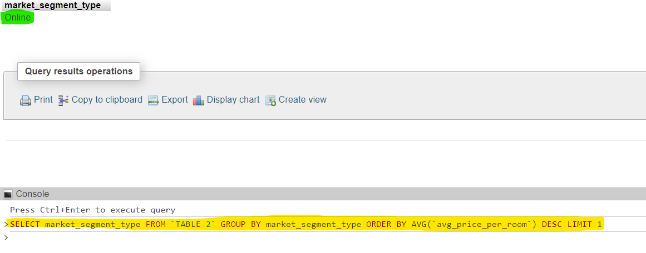
DATA EXPLORATION AND ANALYSIS
Query 15
15. Find the market segment type that generates the highest average price per room.
Query Result
SQL Query
“Online” market segment generated the highest average price per room.

Slide 22



INSIGHTS
The analysis of the hotel reservation dataset reveals key insights into guest preferences and booking trends. 'Meal plan 1' and 'Room Type 1' are the most popular choices among the 700 reservations, with 123 reservations made in 2017 and 383 including weekend nights. The average room price for reservations involving children is 144.57 units, with lead times ranging from 0 to 443 days.
The 'Online' market segment is the most common and generates the highest average price per room. Overall, there are 1316 adults and 69 children across all reservations, providing valuable insights for strategic decision-making in the hotel.

Slide 23
THANK YOU

